Slide 1

Privacy Enhancing Technologies and Their Applications
Sam Leder | Aalborg

Slide 2


Introduction
Cryptography researcher
Background in applied mathematics
TNO: Netherlands Organisation for Applied Scientific Research

Slide 6

Privacy Enhancing Technologies
More data gives more accurate results
But data is sensitive
Share insights, not data

Slide 7
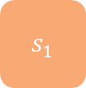

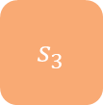

A secret sharing scheme
$s$
$s_{1}$
$s_{2}$
$s_{3}$
Sharing a secret

Slide 8
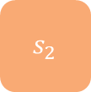









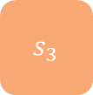
A secret sharing scheme
$s$
$s_{1}$
$s_{2}$
$s_{3}$
$s_{1}$
$s_{3}$
$s_{1}$
$s_{2}$
$s_{3}$
$s$
$?$
Sharing a secret
Reconstructing a secret
But can also do calculations on secret-shared values

Slide 9
26
11
7
8
17
3
9
5
31
5
12
14
74
19
28
27

Slide 10
Secure Multi-Party Computation
Distributed computing
Can do any computation securely
Requires significant communication

Slide 11




Use case: logistics
Company A
Company B
Collaboration A & B

Slide 12
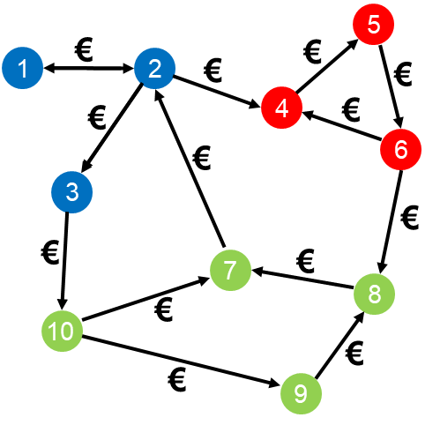
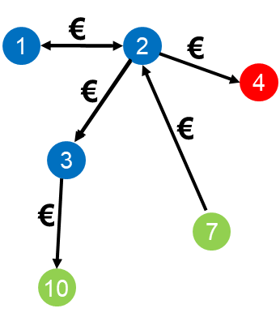
Use case: fraud detection
Transactions visible for one bank
Transaction network (three banks)

Slide 13
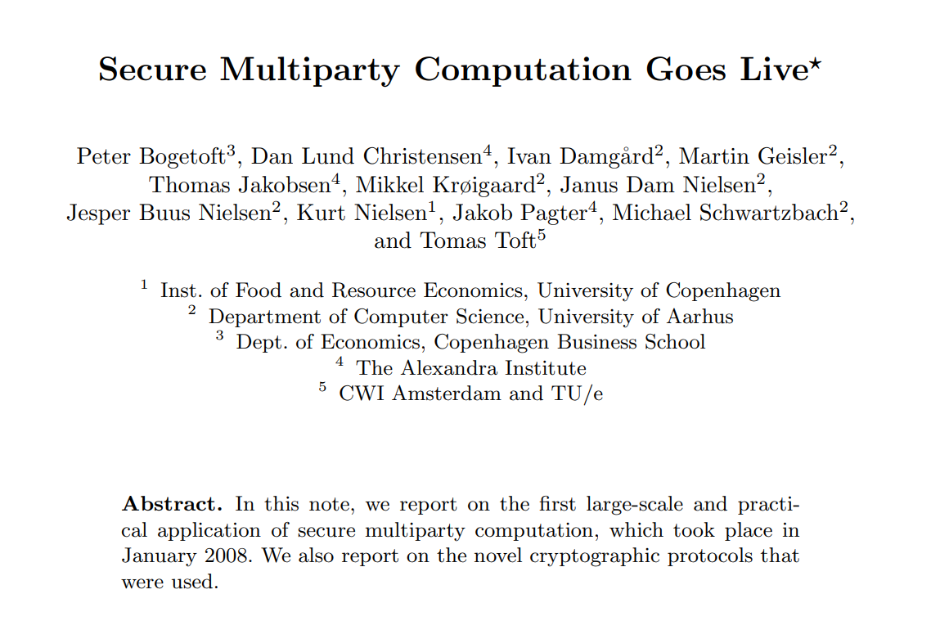
Use case: auctions
Danish Sugar Beet Auction, 2008
Double auction to find market clearing price
Bids and outcomes were secret-shared
25,000 tons of production rights changed owner

Slide 14
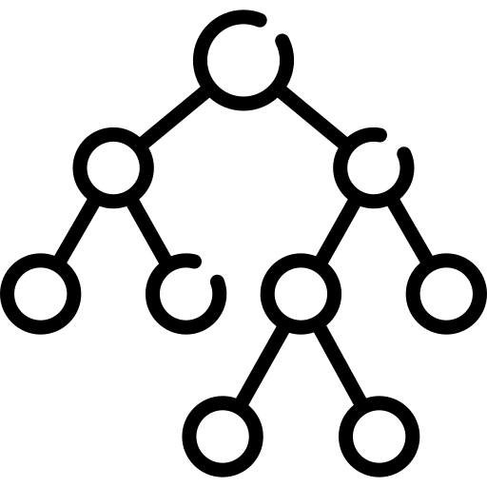
Federated Learning

Slide 15

Federated Learning

Slide 16
Federated Learning

Slide 17
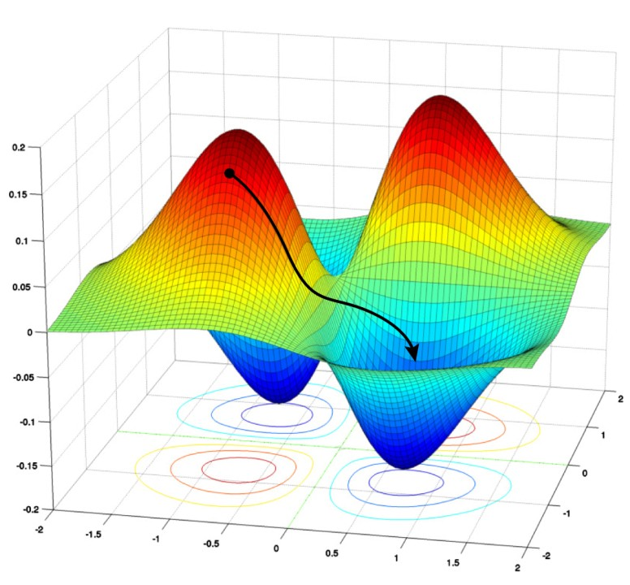
Federated Learning

Slide 18
Federated Learning

Slide 19
Federated Learning
Collaboratively train a model
Parties only share model update
Central node aggregates into central model

Slide 20
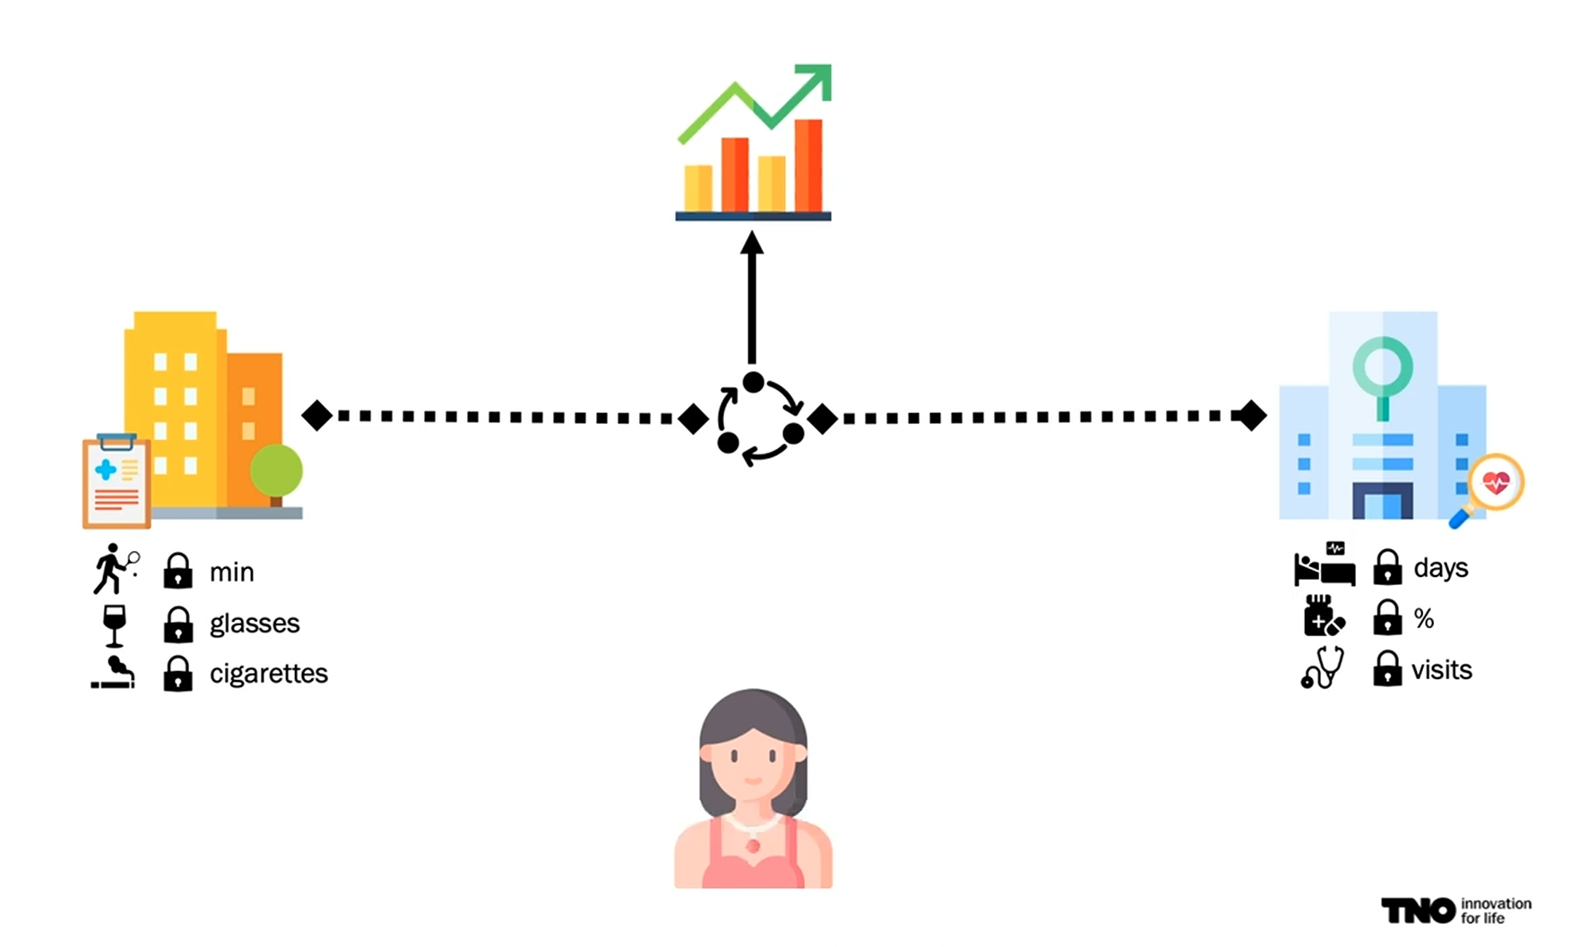
CONVINCED
Research project with IKNL (Netherlands Cancer Registry),
where studies often require multiple data sources

Slide 21
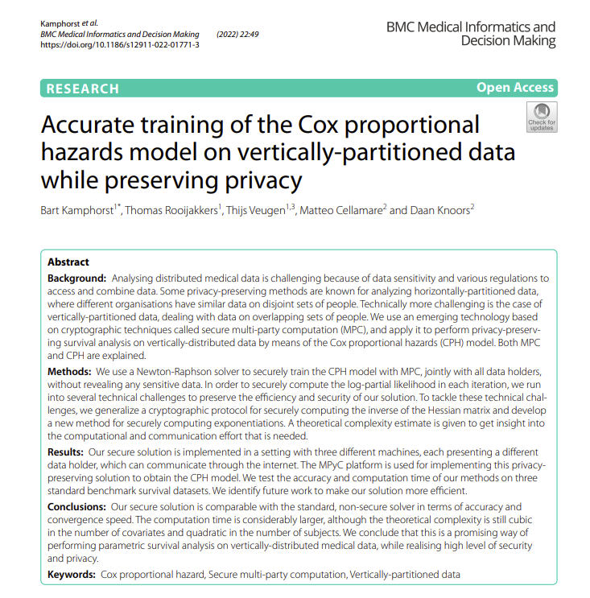
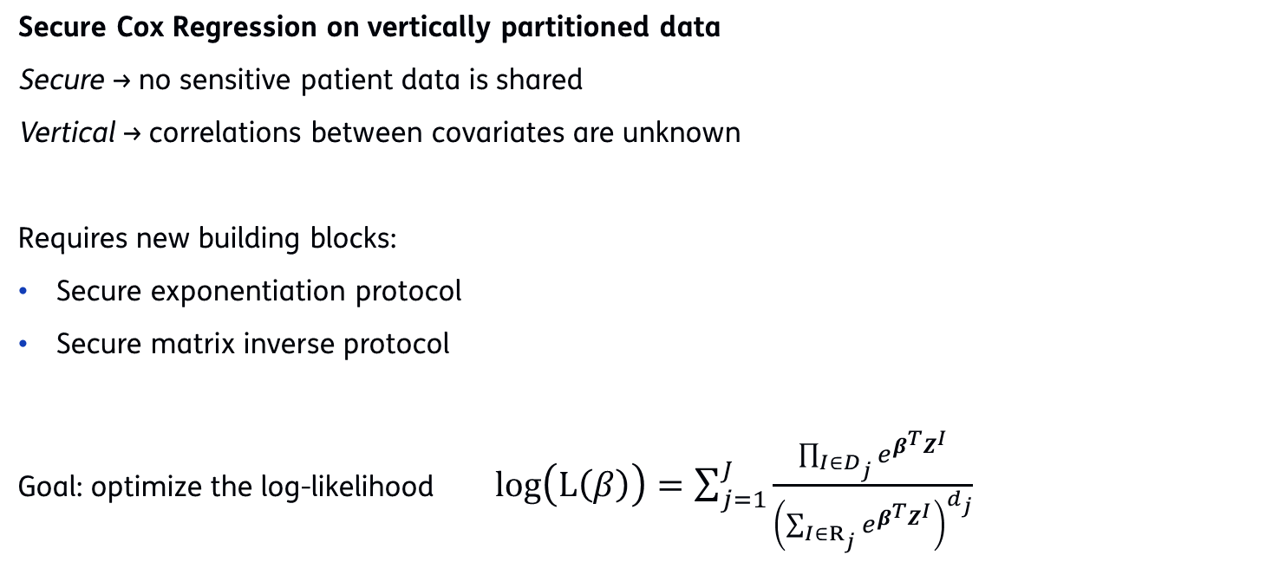
Methods
Secure Cox Regression on vertically partitioned data
Secure → no sensitive patient data is shared
Vertical → correlations between covariates are unknown
Requires new building blocks:
Secure exponentiation protocol
Secure matrix inverse protocol
Goal: optimize the log-likelihood $log\left(\text{L}\left(β\right)\right)=\sum_{j=1}^{J}{\frac{\prod_{I∈D_{j}}{e^{β^{T}Z^{I}}}}{{\left(\sum_{I∈R_{j}}{e^{β^{T}Z^{I}}}\right)}^{d_{j}}}}$

Slide 22
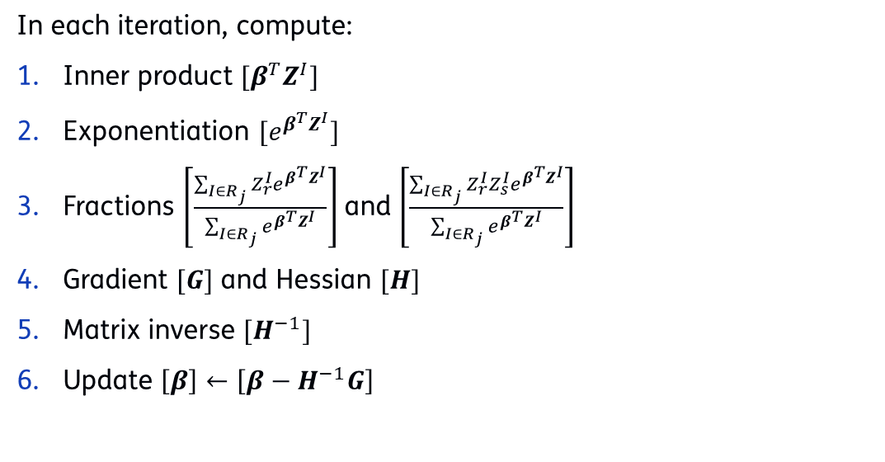
MPC Approach
In each iteration, compute:
Inner product ${[β}^{T}Z^{I}]$
Exponentiation $[e^{β^{T}Z^{I}}]$
Fractions $\left[\frac{\sum_{I∈R_{j}}{Z_{r}^{I}e^{β^{T}Z^{I}}}}{\sum_{I∈R_{j}}{e^{β^{T}Z^{I}}}}\right]$ and $\left[\frac{\sum_{I∈R_{j}}{Z_{r}^{I}Z_{s}^{I}e^{β^{T}Z^{I}}}}{\sum_{I∈R_{j}}{e^{β^{T}Z^{I}}}}\right]$
Gradient $[G]$ and Hessian $[H]$
Matrix inverse $[H^{−1}]$
Update $\left[β\right]←\left[β−H^{−1}G\right]$

Slide 23
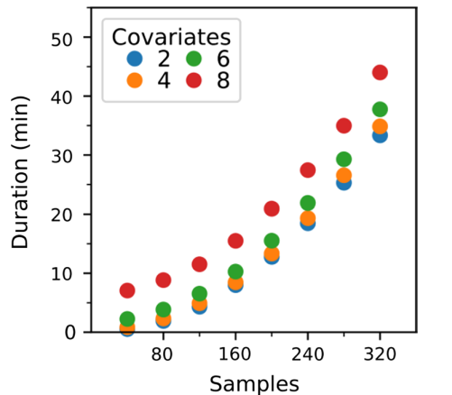
Results
First time MPC has been used for Vertical CPH
Also performed Kaplan-Meier + log rank test with MPC
Produced open-source implementation
Protocol does not scale well for usage in large datasets

Slide 24
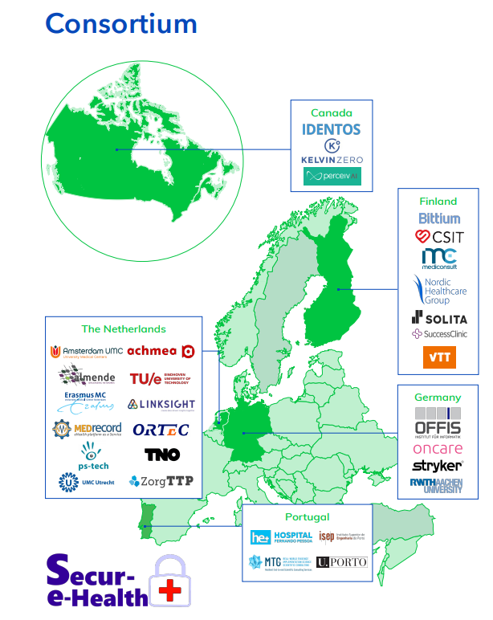

Secur-e-Health
International research project with hospitals, universities, IT-providers
Efficiently implement secure technologies in the health domain
Pilot in the Netherlands

Slide 25
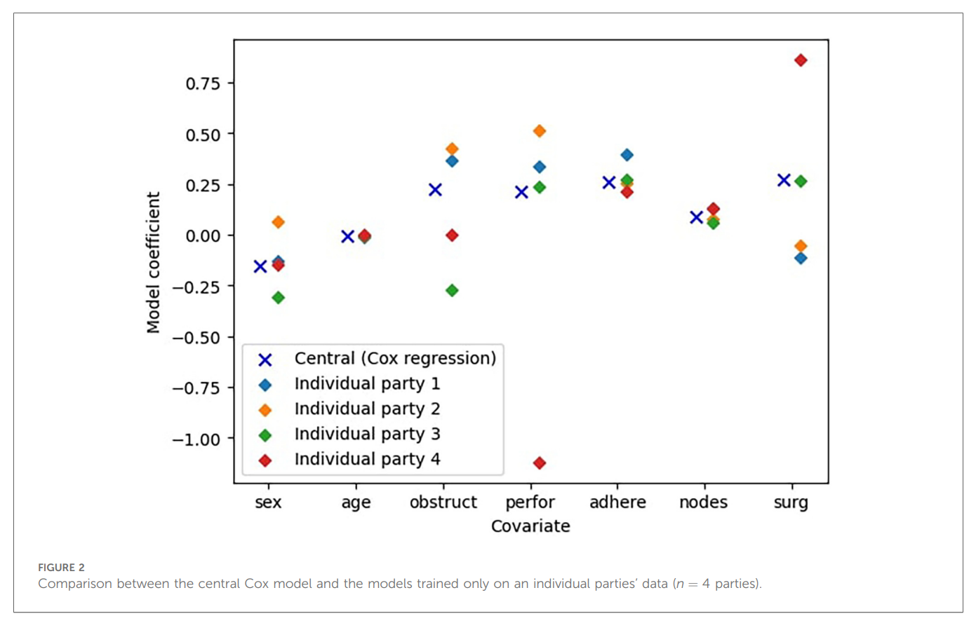

Slide 26
Cox Regression
Motivation: not enough data at individual parties
Data is partitioned horizontally → Federated Learning
However, FL requires a separable loss function
There are some ways to resolve this, we use:
Survival stacking: casting survival analysis as a classification problem (Craig et al., 2021)

Slide 27
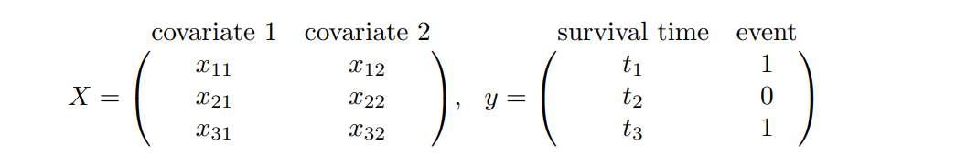
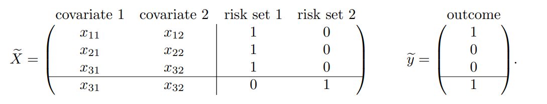
Survival stacking

Slide 28
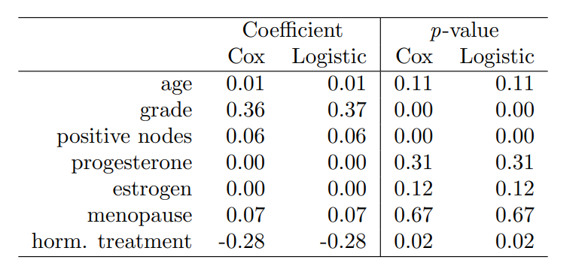
Survival stacking

Slide 29
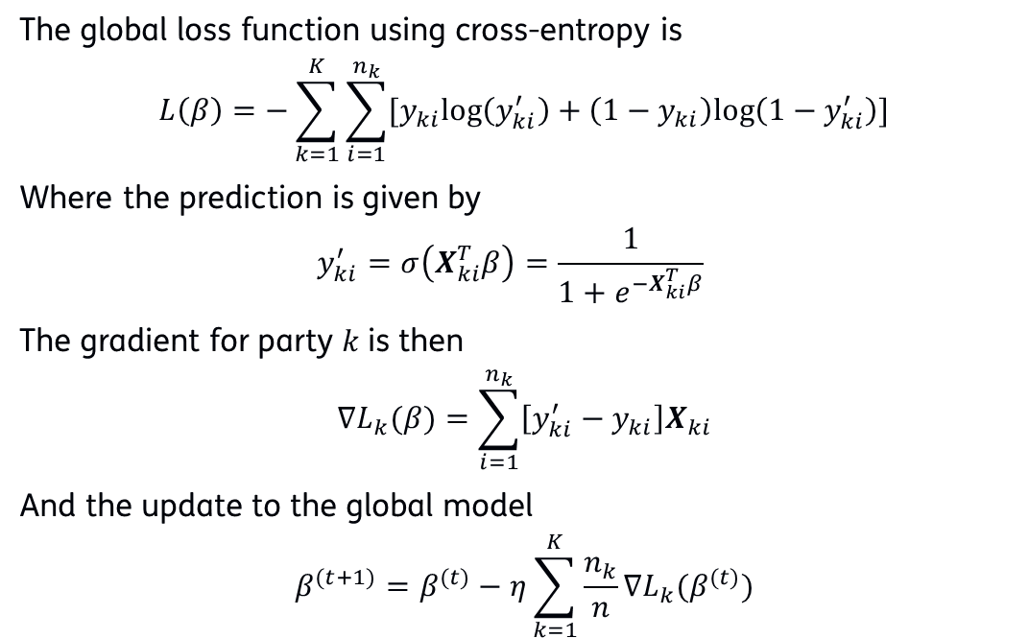
Federated Logistic Regression
The global loss function using cross-entropy is
$$L\left(β\right)=−\sum_{k=1}^{K}{\sum_{i=1}^{n_{k}}{[y_{ki}log\left(y_{ki}^{′}\right)+\left(1−y_{ki}\right)log\left(1−y_{ki}^{′}\right)]}}$$
Where the prediction is given by
  $$y_{ki}^{′}=σ\left(X_{ki}^{T}β\right)=\frac{1}{1+e^{−X_{ki}^{T}β}}$$
The gradient for party $k$ is then
$$∇L_{k}(β)=\sum_{i=1}^{n_{k}}{\left[y_{ki}^{′}−y_{ki}\right]X_{ki}}$$
And the update to the global model
$$β^{(t+1)}=β^{(t)}−η\sum_{k=1}^{K}{\frac{n_{k}}{n}}∇L_{k}(β^{(t)})$$

Slide 30
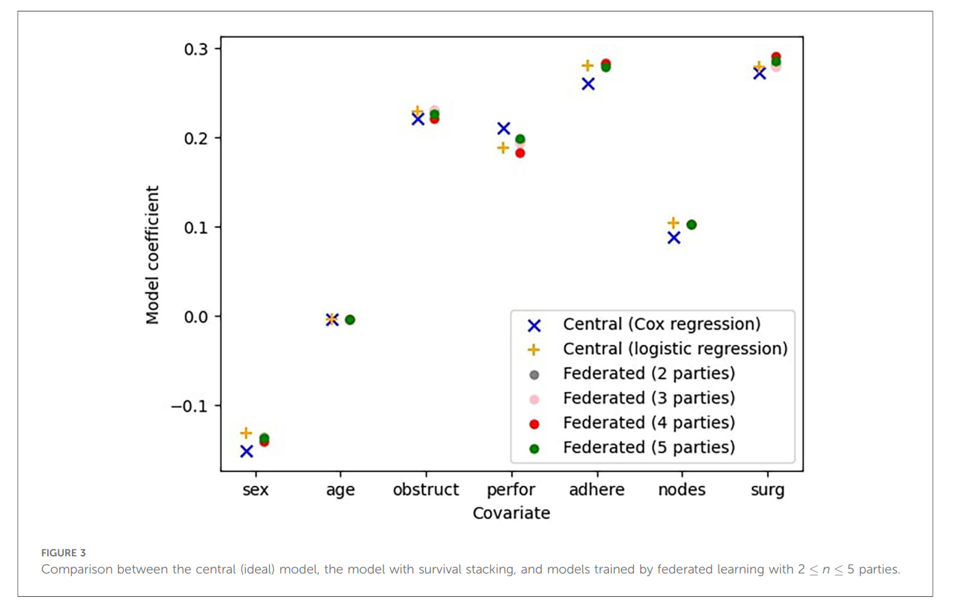
Results
Event times do not have to be shared
Very accurate models
Approach is very efficient
FL works much better than individual models
  5 – 8 times as accurate

Slide 32
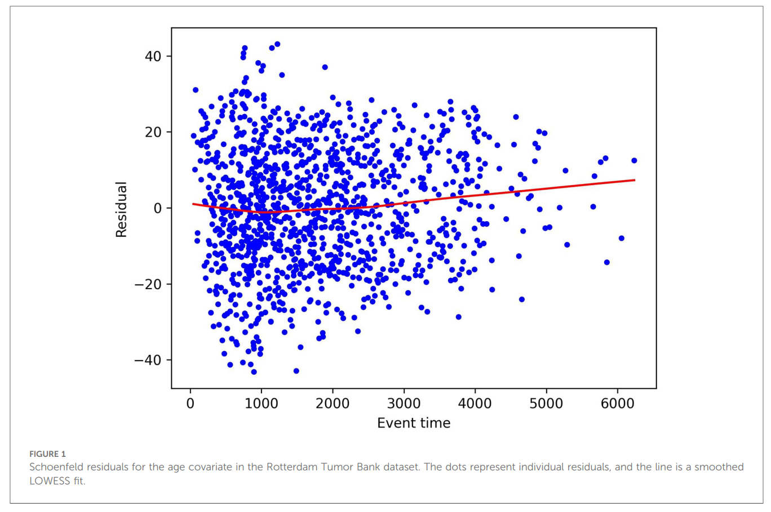
Schoenfeld Residuals
Validate proportional hazards assumption
Partial residuals for the proportional hazards regression model (Schoenfeld, 1982)
Compare actual covariates to those “predicted” by the model
  Risk-weighted average over risk set
If the assumption holds, looks like random noise
Developed novel MPC protocol

Slide 33

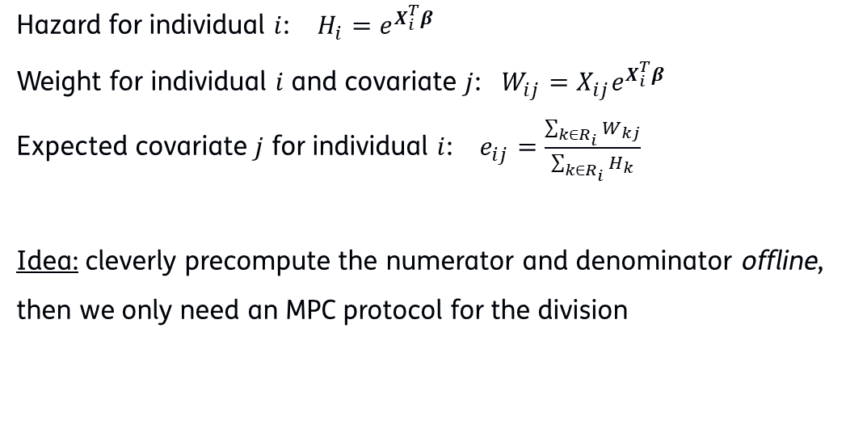
MPC Schoenfeld Residuals
Hazard for individual $i$: $H_{i}=e^{X_{i}^{T}β}$
Weight for individual $i$ and covariate $j$: $W_{ij}=X_{ij}e^{X_{i}^{T}β}$
Expected covariate $j$ for individual $i$: $e_{ij}=\frac{\sum_{k∈R_{i}}{W_{kj}}}{\sum_{k∈R_{i}}{H_{k}}}$
Idea: cleverly precompute the numerator and denominator offline,
then we only need an MPC protocol for the division

Slide 34

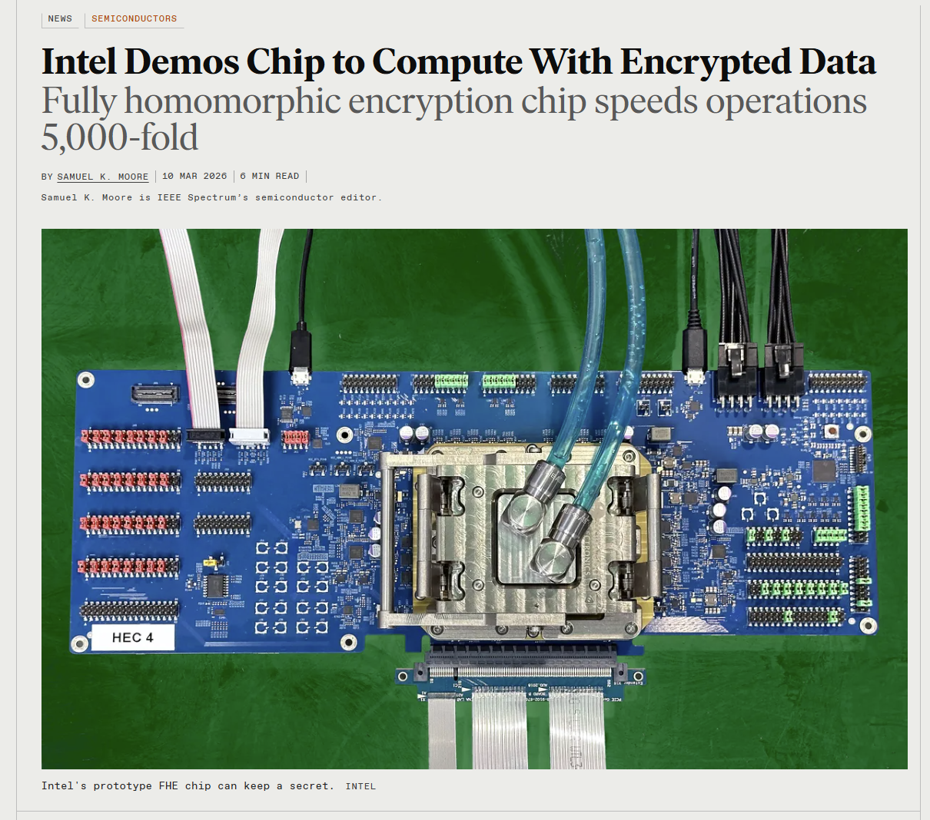
Outlook
MPC alliance Europe
Market maturity and startups
  Linksight, Roseman Labs (Netherlands)
  Partisia (Denmark)
Other PETs
  FHE: encrypted cloud computation →
  ZKP: automated compliance

Slide 35

Thank you for your attention
Contact: sam.leder@tno.nl

